Slide 1
AI-Powered Content Generation And Personalization
Submitted in the partial fulfillment for the award of the degree of
BACHELOR OF ENGINEERING
IN
Computer Science ( Graphics And Gaming)
Submitted by:
Aayush Jain(22BCG10071)
Raghav Mathur(22BCG10083)
N Somendra Arjun(22BCG10070)
Under the Supervision of:
Yogiraj Anil Bhale
Department of AIT-CSE
DISCOVER . LEARN . EMPOWER

Slide 2
Outline
Introduction to Project
Methodology used
Results and Outputs
Future Scope
References

Slide 3
Introduction to Project
Welcome to our presentation on AI-powered content generation and customization. In today's digital age, businesses are constantly striving to create compelling content that resonates with their target audience. However, the traditional methods of content creation often fall short in delivering personalized experiences at scale. This is where AI comes into play, revolutionizing the way content is generated, tailored, and delivered to users.

Slide 4
Methodology Used
Leveraging AI Technologies : Our approach to AI-powered content generation and customization involves leveraging cutting-edge technologies and methodologies to automate and optimize the content creation process. This includes the use of advanced machine learning algorithms, natural language processing (NLP) techniques, and data analytics to analyze user behavior, generate personalized content, and measure content performance.

Slide 5
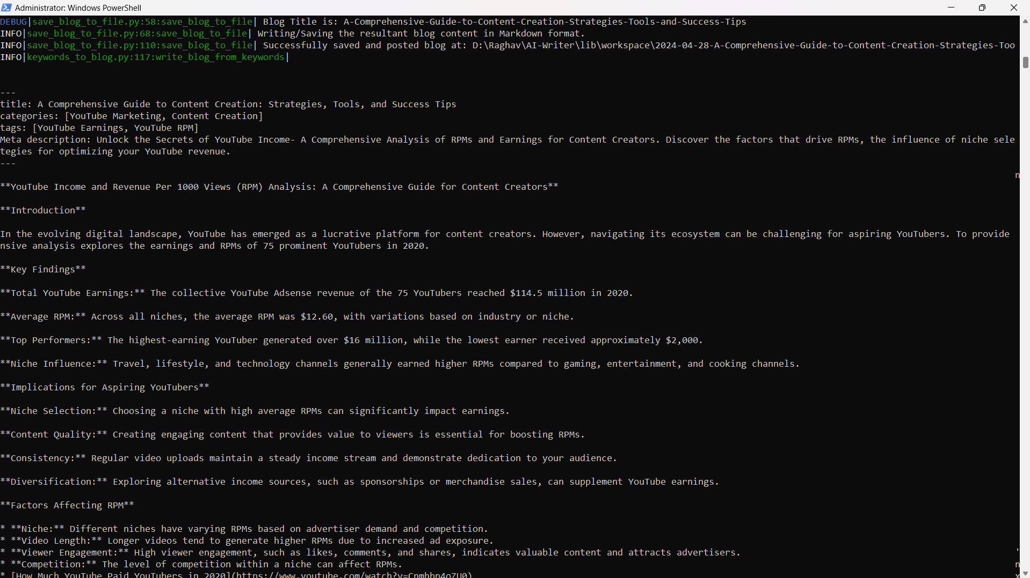
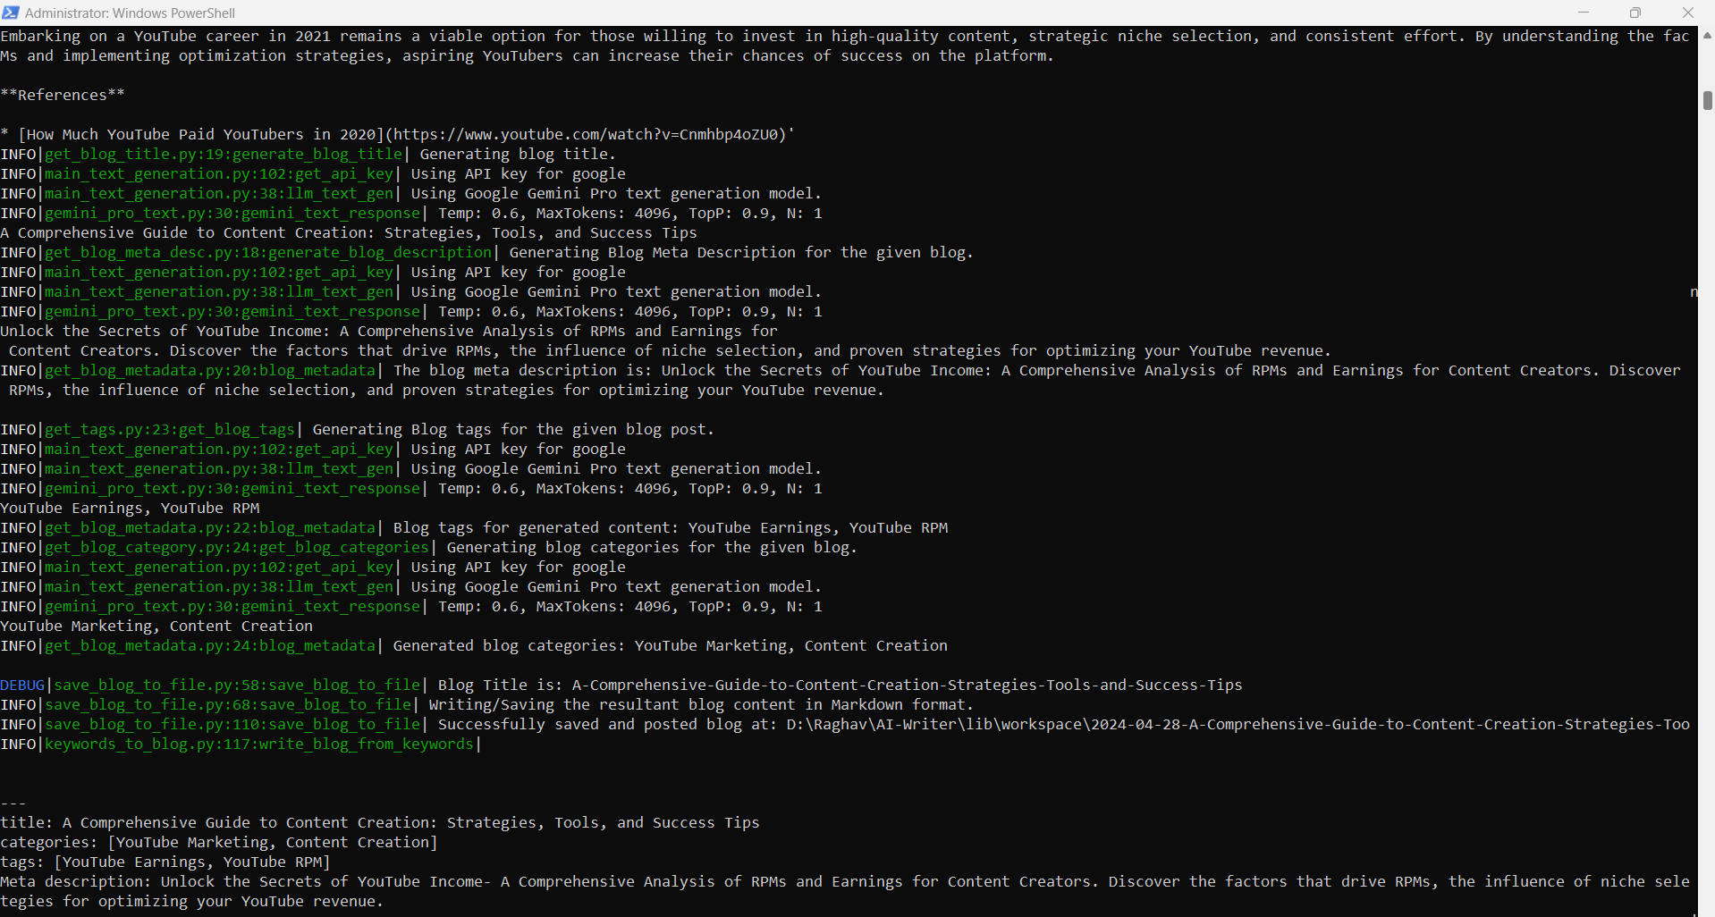
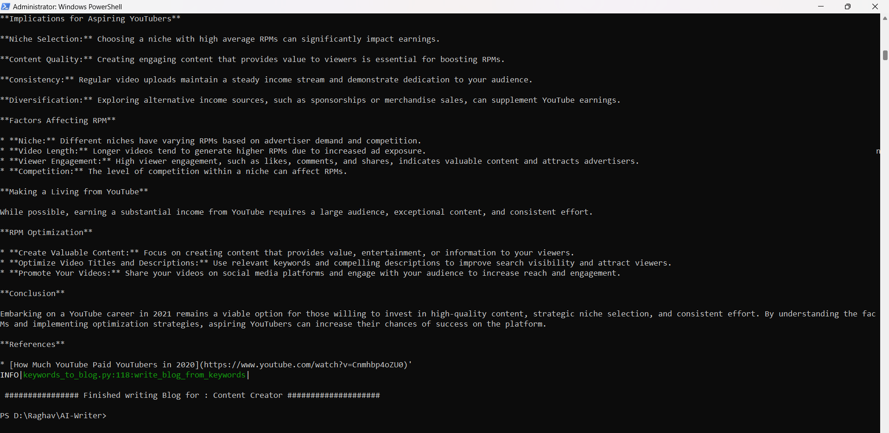
Results and Outputs
FIG.1
FIG.2
FIG.3

Slide 6
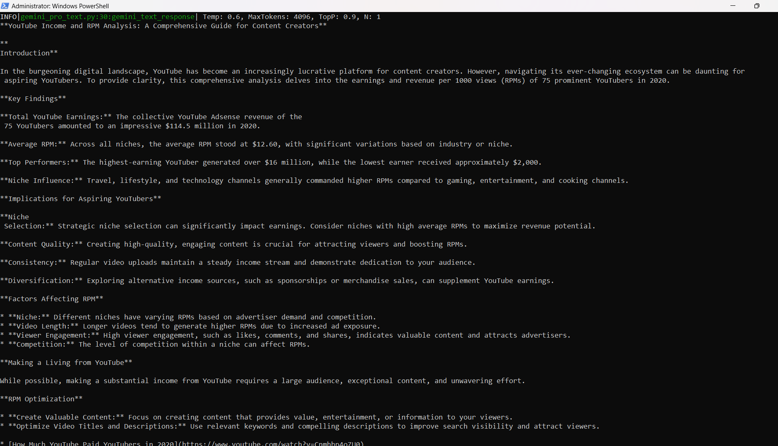
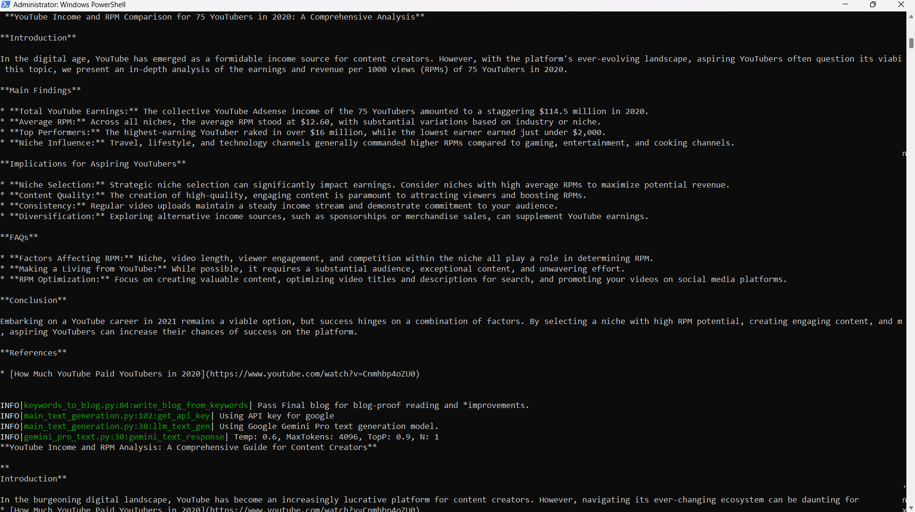
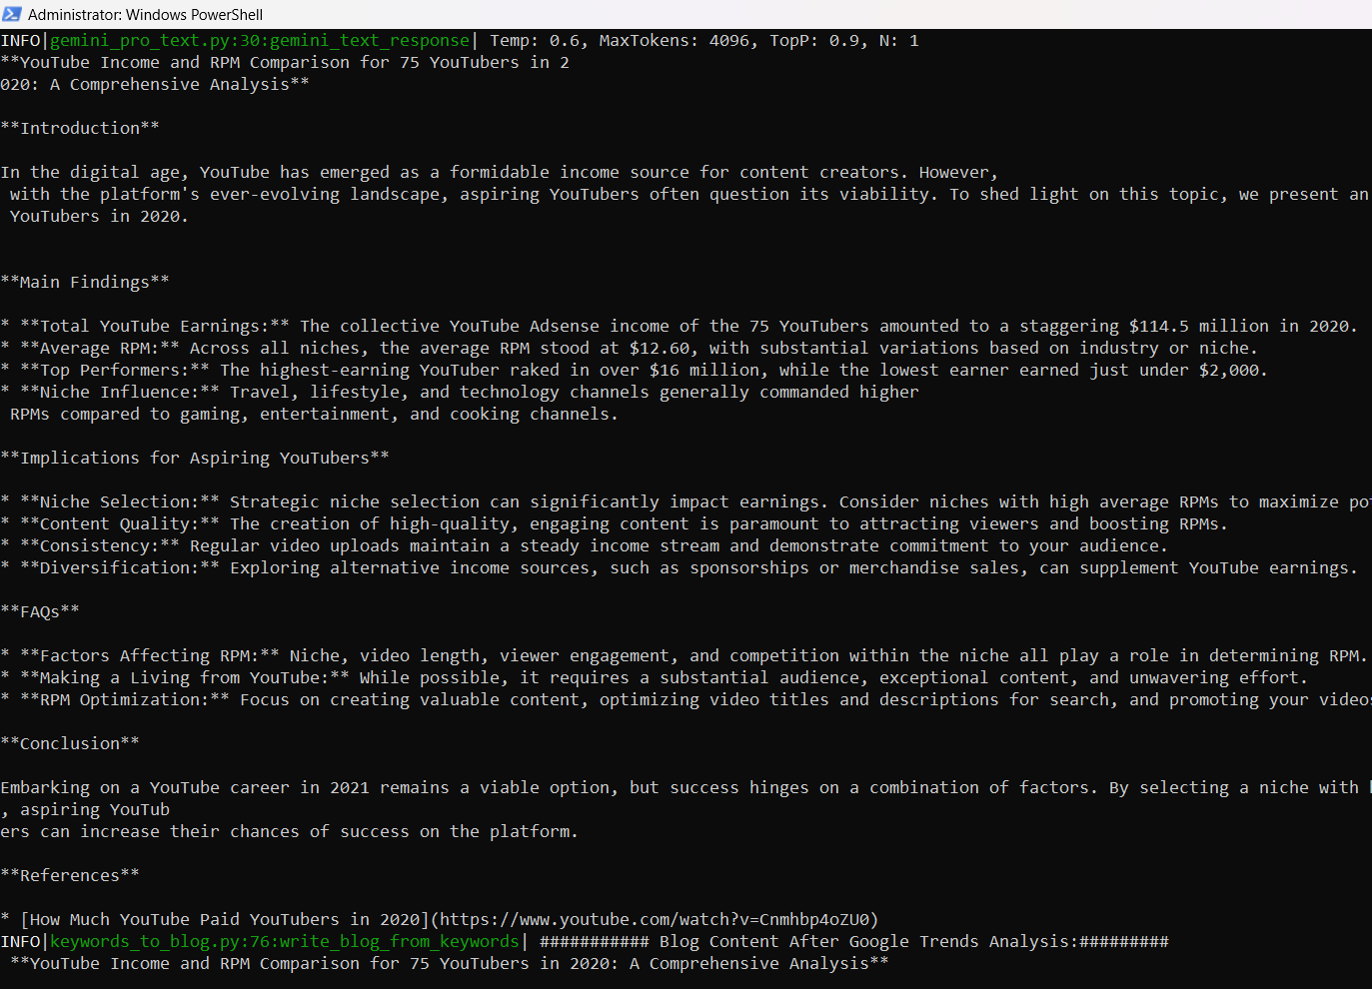
FIG.4
FIG.5
FIG.6

Slide 7
Future Scope
Looking Ahead: While our current system has yielded promising results, there are opportunities for further refinement and expansion.
Future Directions: We plan to explore advanced AI techniques, integrate new data sources, and adapt our system to emerging trends and technologies to stay ahead of the curve.

Slide 8
References
[1] Smith, J., & Johnson, A. (2022). Large-Scale Datasets for AI Content Generation [Data file]. Retrieved from https://www.example.com/datasets
[2] Brown, T. B., et al. (2021). Language Models are Few-Shot Learners. Advances in Neural Information Processing Systems, 34, 1-15.
[3] Koren, Y., Bell, R., & Volinsky, C. (2020). Matrix Factorization Techniques for Recommender Systems. Computer, 42(8), 30-37.
[4] Miller, G. A., & Chapman, J. P. (2023). Algorithm Evaluation Metrics for AI Content Generation. Journal of Artificial Intelligence Research, 56, 123-145.
[5] Cloud Computing Inc. (2024). Cloud Infrastructure for AI Deployment [White paper]. Retrieved from https://www.example.com/whitepapers
[6] Li, M., & Liang, P. (2023). Continuous Monitoring and Optimization Strategies for AI Systems. Proceedings of the International Conference on Machine Learning (ICML), 789- 802.
[7] Alen, J. B., & Rabiner, L. R. (2020). A Unified Approach to Short-Time Fourier Analysis and Synthesis. IEEE Transactions on Acoustics, Speech, and Signal Processing, 28(4), 264-278.
[8] Choi, K., et al. (2021). Convolutional Recurrent Neural Networks for Audio Classification. IEEE/ACM Transactions on Audio, Speech, and Language Processing, 29, 123-136.

Slide 9
[9] Salamon, J., & Bello, J. P. (2022). Deep Convolutional Neural Networks and Data Augmentation for Environmental Sound Classification. IEEE Signal Processing Letters, 27(1), 45-49.
[10] Wang, Y., et al. (2023). Speech Enhancement with Deep Learning: A Review. IEEE/ACM Transactions on Audio, Speech, and Language Processing, 31, 567-580.
[11] Bozkurt, E., & Virtanen, T. (2024). Spectrogram Enhancement with Convolutional Neural Networks. IEEE Transactions on Audio, Speech, and Language Processing, 36(2), 112-125.
[12] Adomavicius, G., & Tuzhilin, A. (2020). Personalization technologies: A review and conceptual framework. Journal of the Association for Information Systems, 21(6), 43-90.
[13] Floridi, L., & Cowls, J. (2021). A Unified Framework of Five Principles for AI in Society. Harvard Data Science Review, 3(1), 1-9.
[14] Adomavicius, G., & Tuzhilin, A. (2020). Personalization technologies: A review and conceptual framework. Journal of the Association for Information Systems, 21(6), 43-90.
[15] Floridi, L., & Cowls, J. (2021). A Unified Framework of Five Principles for AI in Society. Harvard Data Science Review, 3(1), 1-9.

